Slide 1
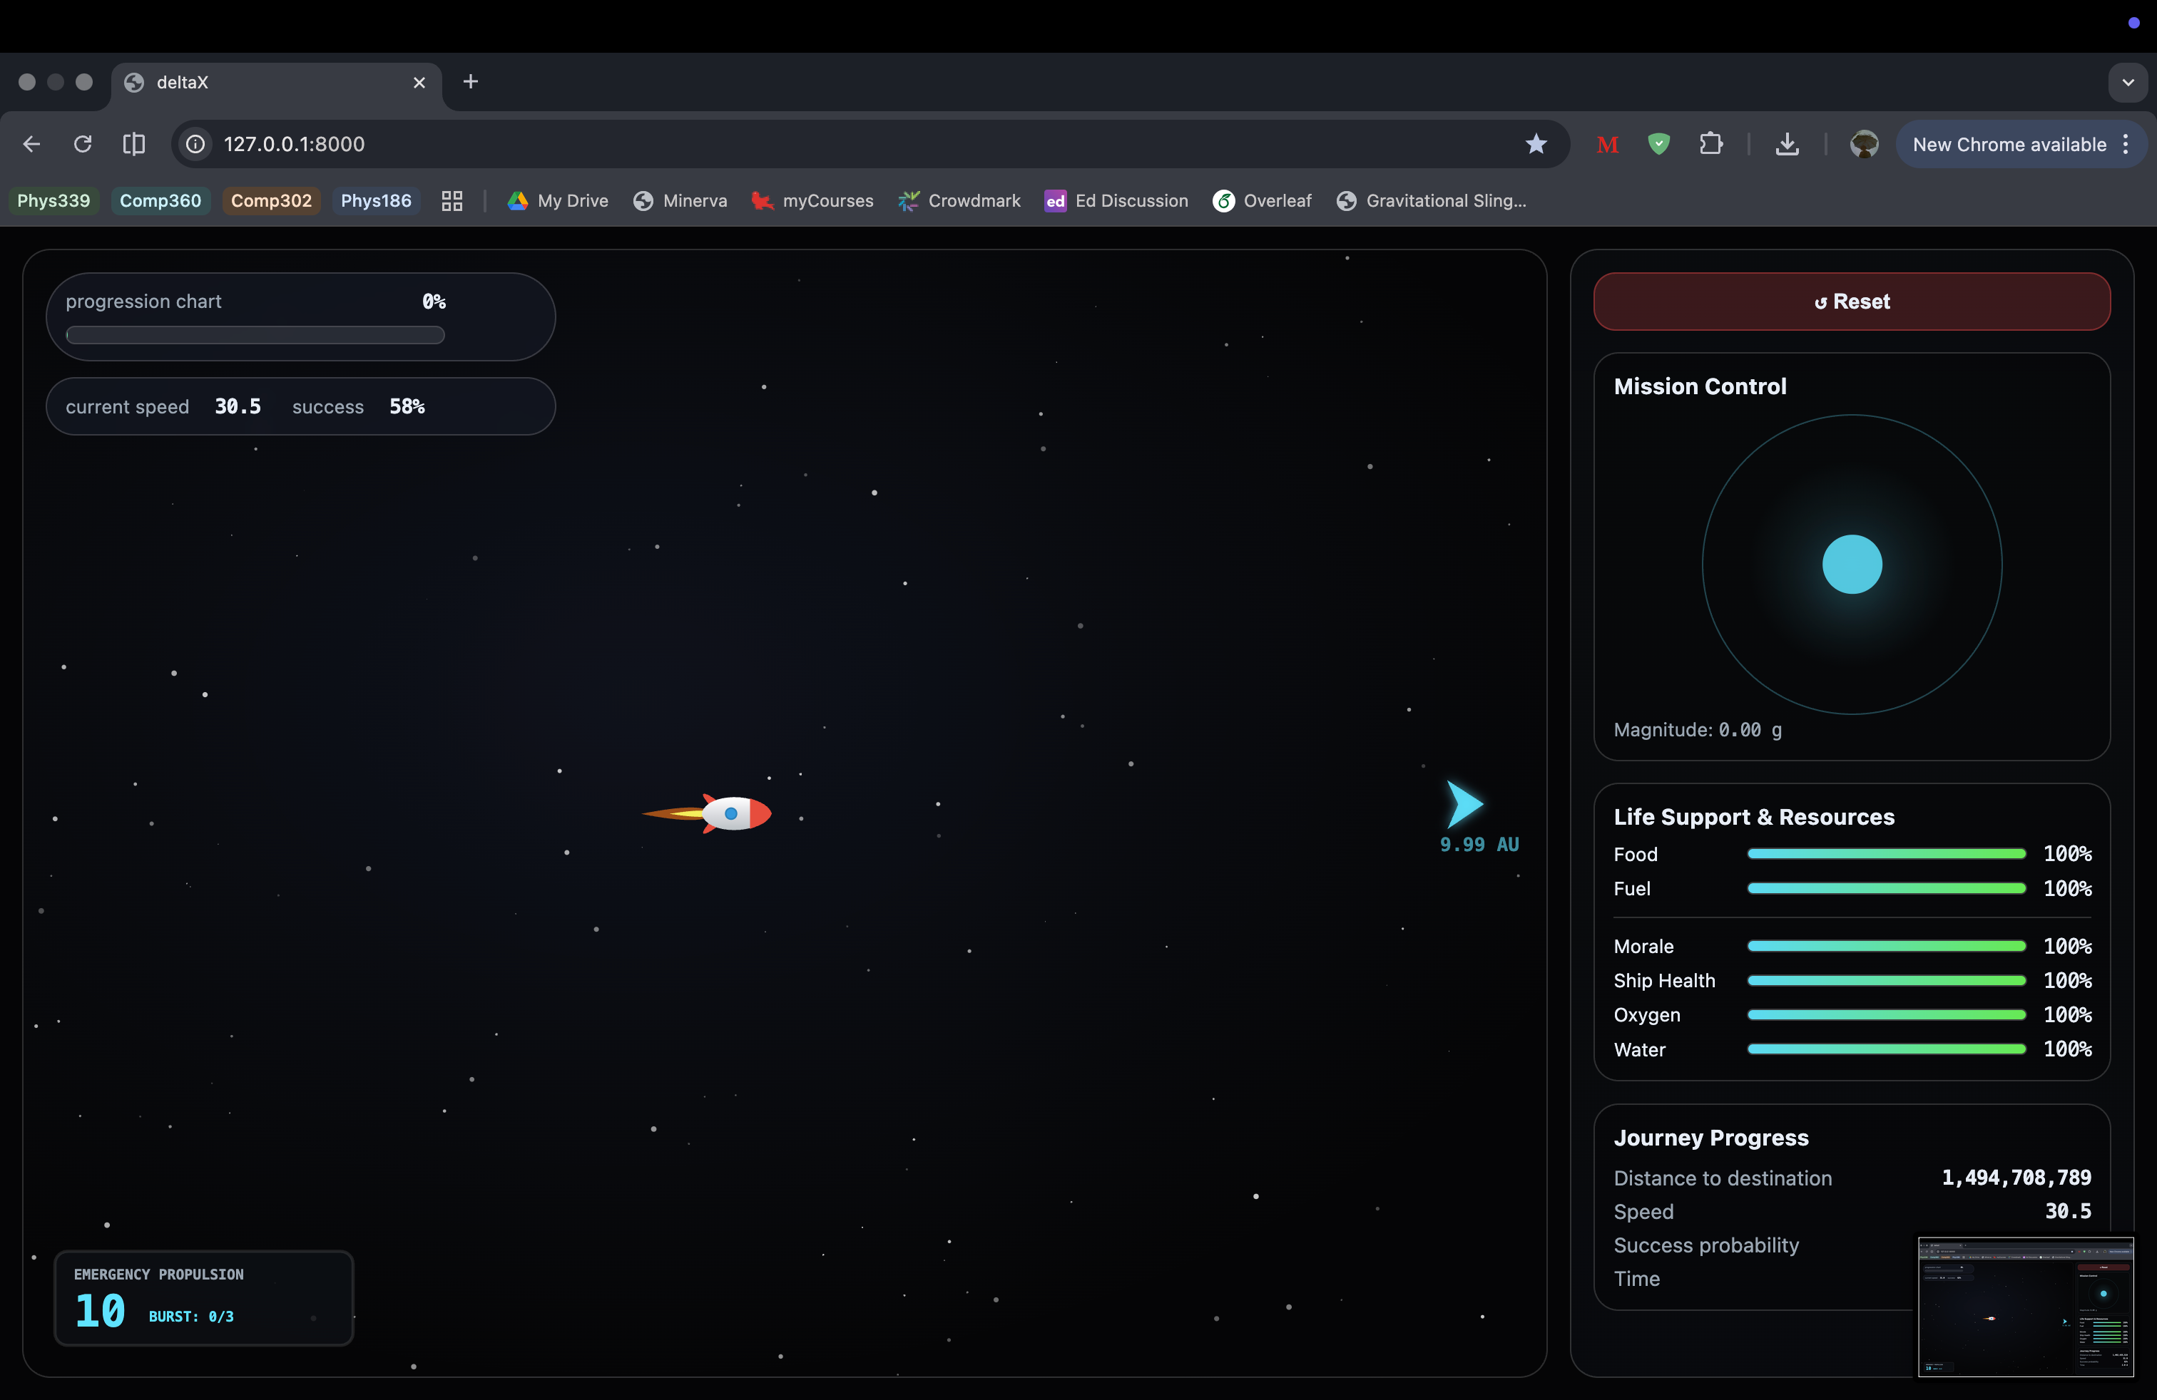
Delta Duo
by Ana & Yun Lei

Slide 2
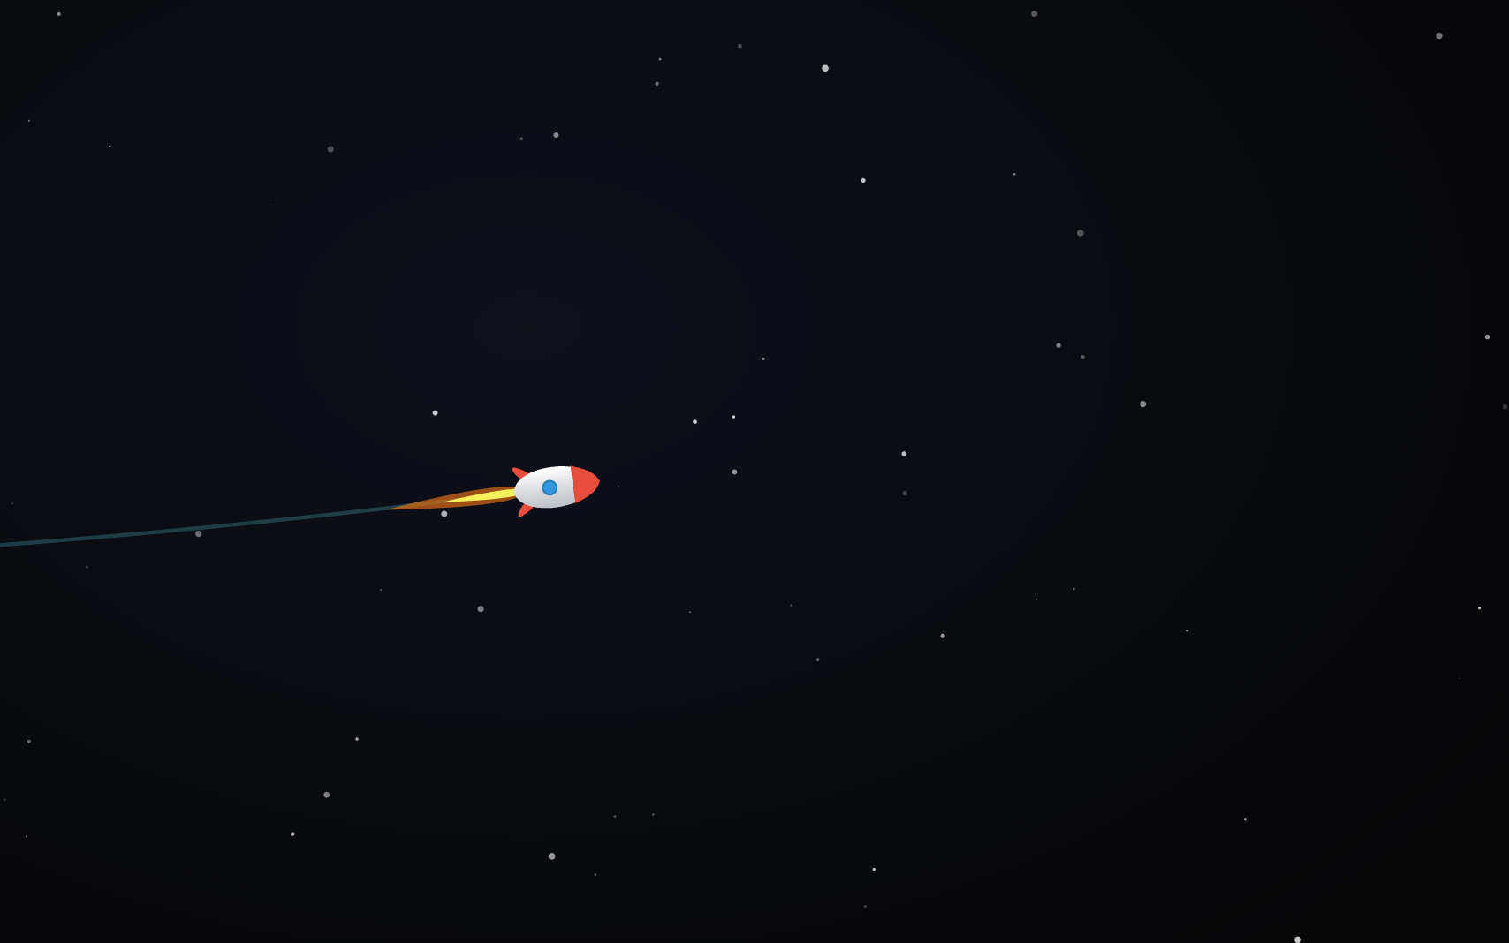
“Ten little astronauts flying way up high…
One drifted off too far… and then there were nine.”

Slide 3
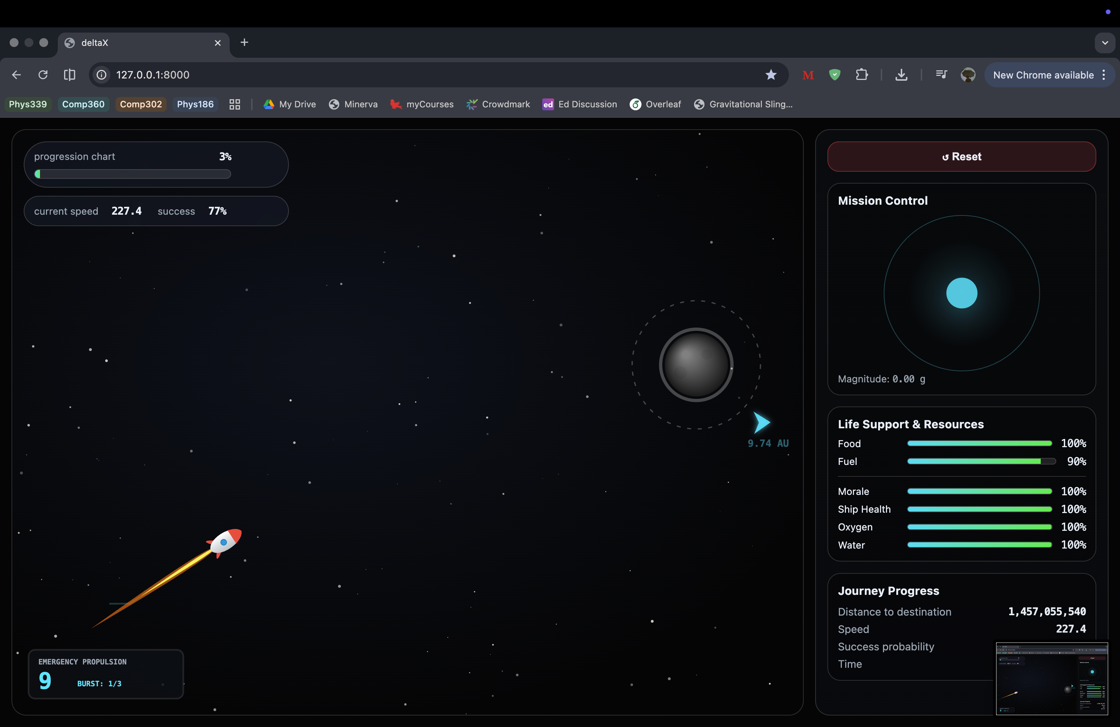
In deltaX, you are Mission Control.
You don’t fly the ship directly — you only influence it using small propulsion burns.
The goal is simple: reach Earth.

Slide 4
DEMO

Slide 5
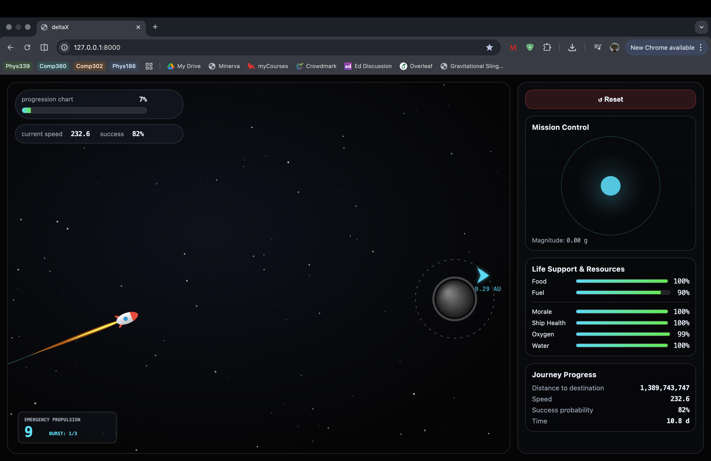
Aesthetics
We focused on making it feel like a cinematic mission control UI.

Slide 6
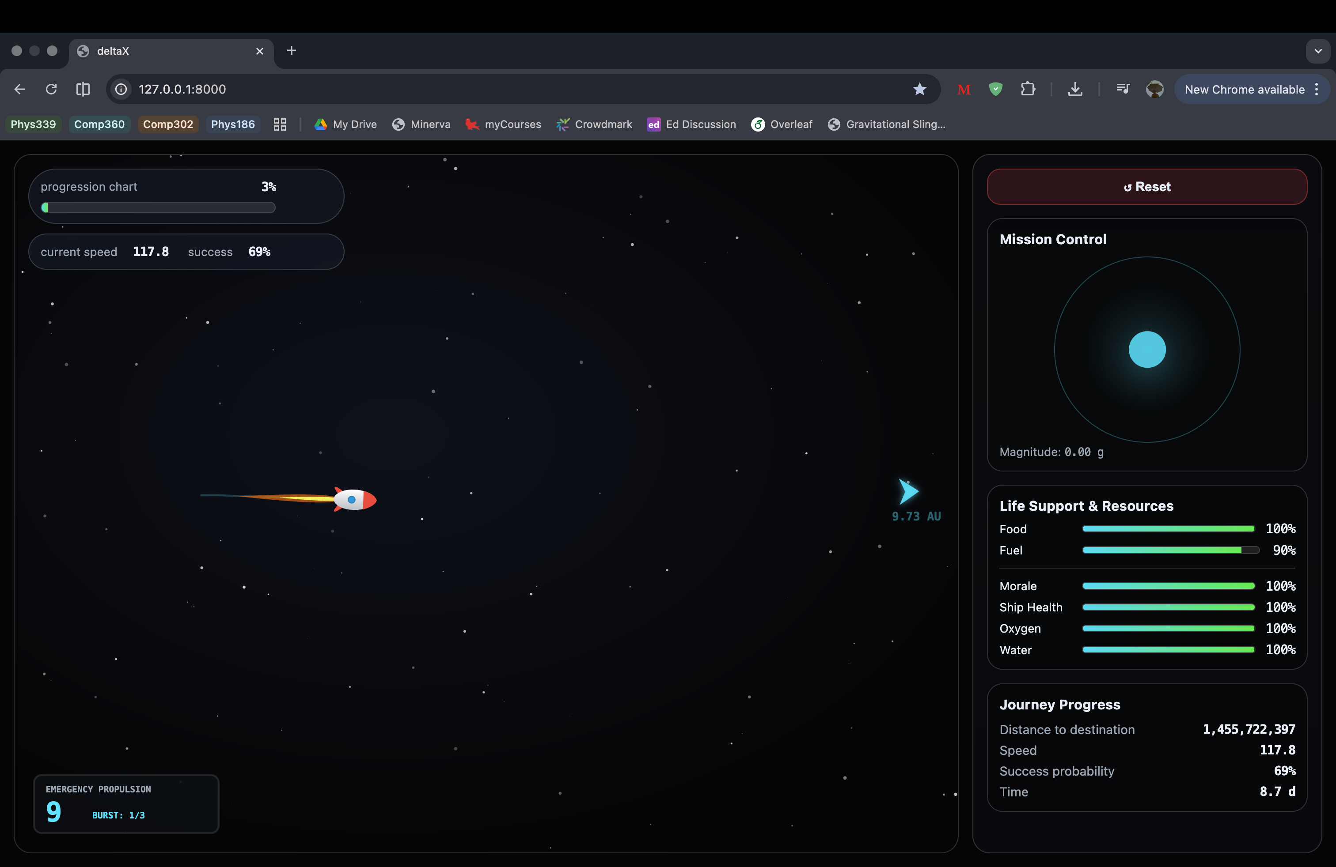
Technical
We built a full backend simulation in Python, with frontend rendering and real-time interaction.

Slide 7
Communication
The goal is intuitive: guide the ship, manage resources, survive events, reach Earth.

Slide 8
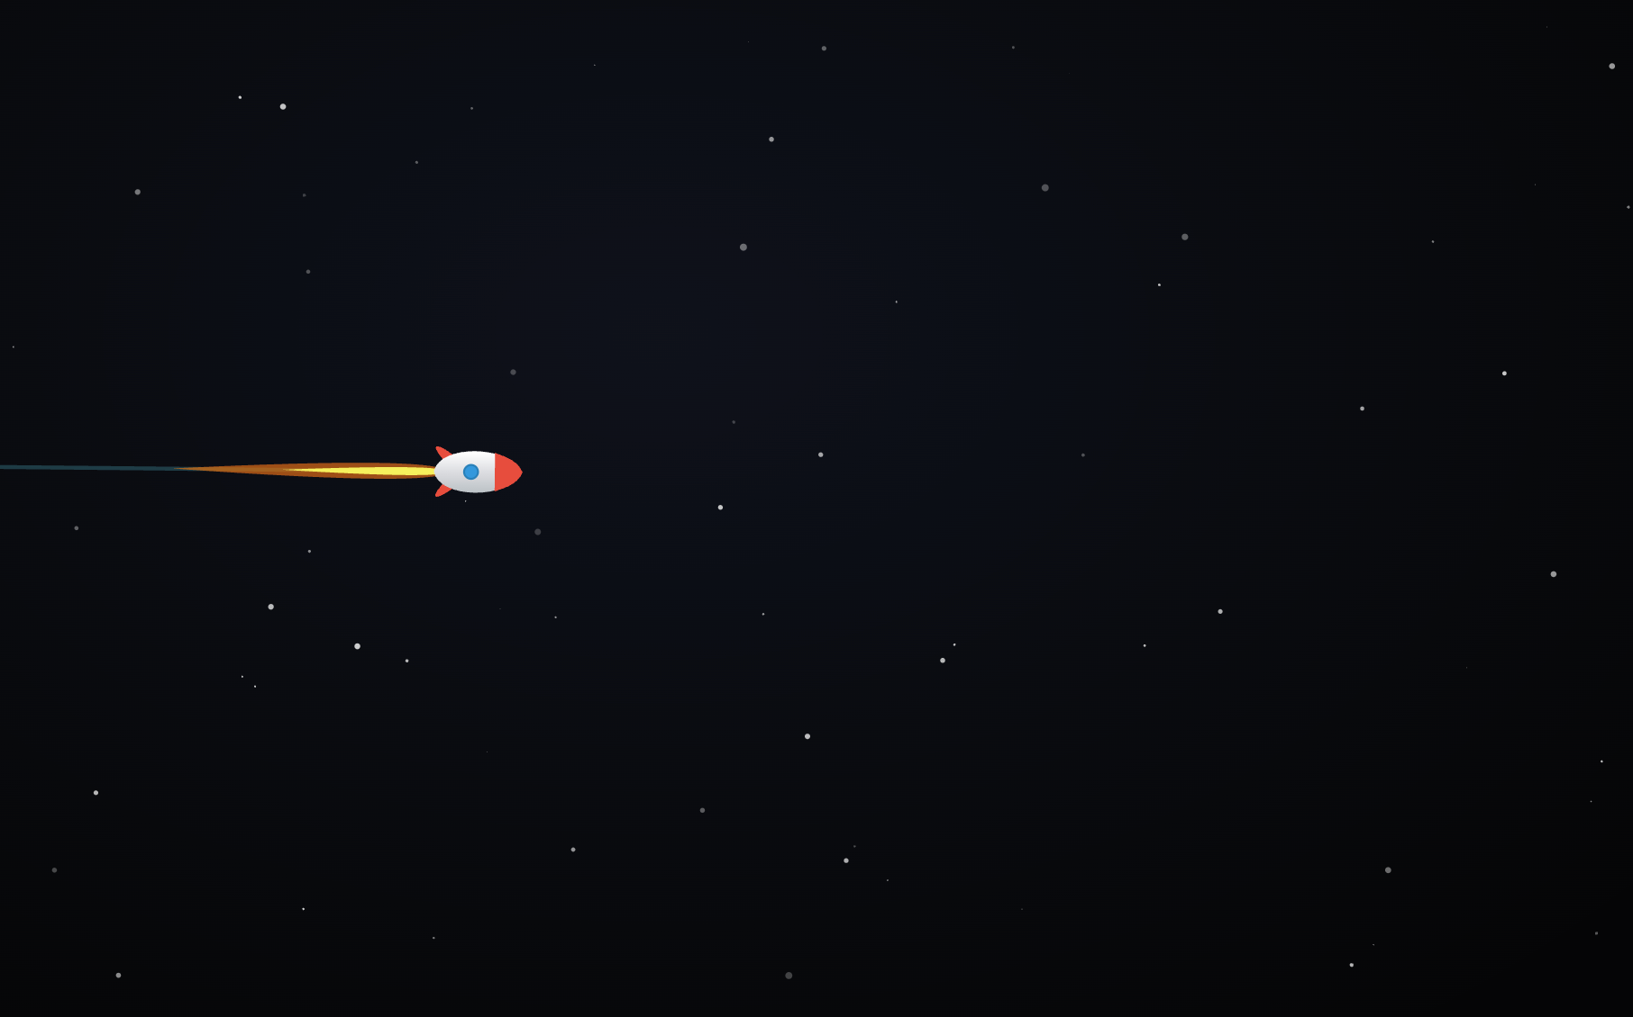
Physics Complexity
We show gravity-based planetary influence and orbital capture, chaos through sensitivity to initial conditions, and butterfly effect behavior.

Slide 9
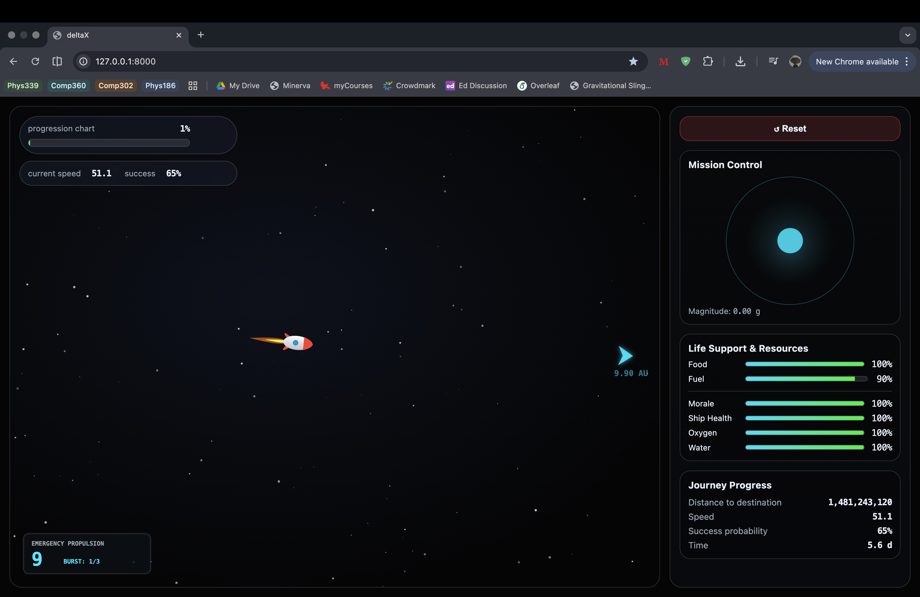
“Ten little astronauts flying way up high…
With the right decisions … all get to survive.”
“But let the system drift…
A tiny error grows…
and then there were none.”

